Slide 1

Call Centre Dashboard – Power BI Project Presentation
Submitted By :
SAGAR SS
Data Analytics

Slide 2
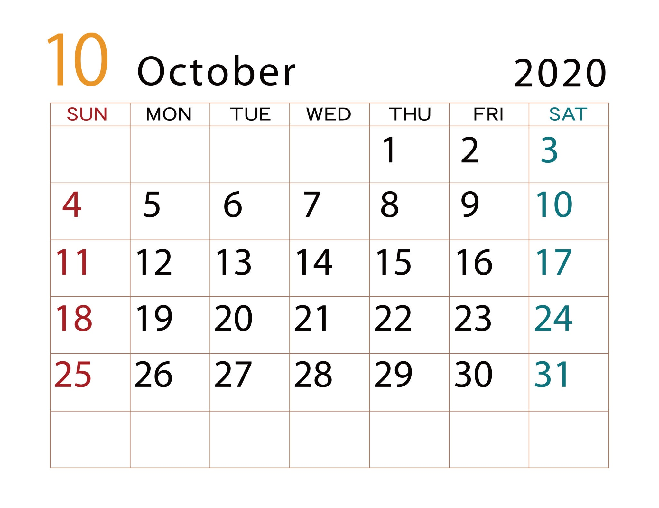
Call Centre Dashboard using Power BI
Objective:
To analyze call centre operations and provide insights into performance, customer experience, and efficiency for October 2020.

Slide 3
Introduction
This Power BI project analyzes Call Centre operations for October 2020, focusing on the following performance categories:
Total Calls Received
Calls Resolved vs. Unresolved
Customer Satisfaction Scores
Average Call Duration
Agent and Call-Centre Performance
Call Topics (Billing, Payment, Service, etc.)
Call Channels (Call-Centre, Chatbot, Email, Web)
Customer Sentiment
The analysis includes insights across agents, call types, call centres, and time periods within October 2020, and uses various visualizations to explore operational efficiency, customer experience, and productivity patterns.

Slide 4
Dataset Description
Dataset Period: October 2020
Dataset Source: [From Kaggle]
Dataset Size: Contains records of call centre operations (calls, agents, customer feedback) for one month.
Key Columns & Fields:
Call-Centres – Locations of call centres.
City – Customer city.
State – Customer state.
Channel – Communication channel (Call-Centre, Chatbot, Email, Web).
Reason – Call type (Billing, Payment, Service, etc.).
Sentiment – Customer sentiment (Positive, Negative, Neutral, etc.).
Response Time – Time taken to respond.
Csat Score – Customer satisfaction rating.
Date Table – Date, Day, Day No.

Slide 5
Data Model
The data model consists of:
Fact Table: Call records (calls, duration, sentiment, resolution, etc.)
Dimension Tables: Date Table (Date, Day, Day No.)
Relationships link call records with date and other attributes.

Slide 6
Measures & Calculations (DAX)
The following measures were created in Power BI for this dashboard:
Total Calls
Total Call Duration in Minutes
Call Duration in Hours
Average Call Duration (Min)
Response Time %
These measures power the KPIs and visualizations in the dashboard.

Slide 7
Dashboard Walkthrough - HOME PAGE
The dashboard consists of multiple visualizations:
KPI Cards:
  Calls (Total Calls)
  Call Duration (Hrs)
  Call Duration (Min)
  Avg Call Duration (Min)
  Response Time %

Slide 8
CHARTS :
Bar Chart: Calls by Day (Sun–Sat).
Map Chart: Calls by State.
Treemap: Calls by Reason (Billing, Payment, Service).
Donut Chart: Calls by Channel (Call-Centre, Chatbot, Email, Web).
Bar Chart: Calls by Sentiment (Negative, Neutral, Positive, Very Negative, Very Positive).
Bar Chart: Calls by Call-Centres (Los Angeles, Baltimore, Chicago, Denver).
“In addition to visualizations, the dashboard includes navigation buttons (Home & Grid) that allow users to switch between views seamlessly. This improves user experience and makes the report more interactive.”

Slide 9
Dashboard Walkthrough – Grid Page
Purpose
Shows detailed call-level data for deeper analysis.
Complements the summary view by enabling drill-down.
Key Features
KPIs: Calls, Call Duration (Hrs/Min), Avg Call Duration, Response Time %.
Filters: Date Range, Channel, City.
Detailed Table: Call ID, Customer, Channel, State, Reason, Response Time, City, Call Duration.
Navigation: Switch easily between Home ↔ Grid.
Value
Enables managers to analyze individual calls.
Identifies patterns in response time & call reasons.
Supports both high-level and granular decision-making.

Slide 10
Insights & Findings (October 2020)
Total of 32.94K calls were handled in October 2020.
Average call duration was around 25 minutes.
Billing questions were the most common call reason.
Majority of calls came through the Call-Centre channel (32.3%), followed by Web and Email.
Negative sentiment calls (11.1K) were higher than positive ones.
Among call centres, Los Angeles handled the most calls (14K), followed by Baltimore (11K).
Response Time % stood at 75%, showing scope for improvement.

Slide 11
Conclusion
The Call Centre Dashboard provides an interactive and visual way to monitor call centre performance for October 2020.
Key Benefits:
Clear tracking of call volumes, call duration, and response time.
Insights into customer satisfaction and sentiment.
Visibility into channel-wise and location-wise performance.
Data-driven support for improving call centre operations.
Future Scope:
Predictive analysis for call volume forecasting.
Deeper sentiment analysis using text mining/AI.
“The inclusion of navigation buttons enhances interactivity, ensuring that stakeholders can easily move across different report pages and focus on specific analyses.”

Slide 12
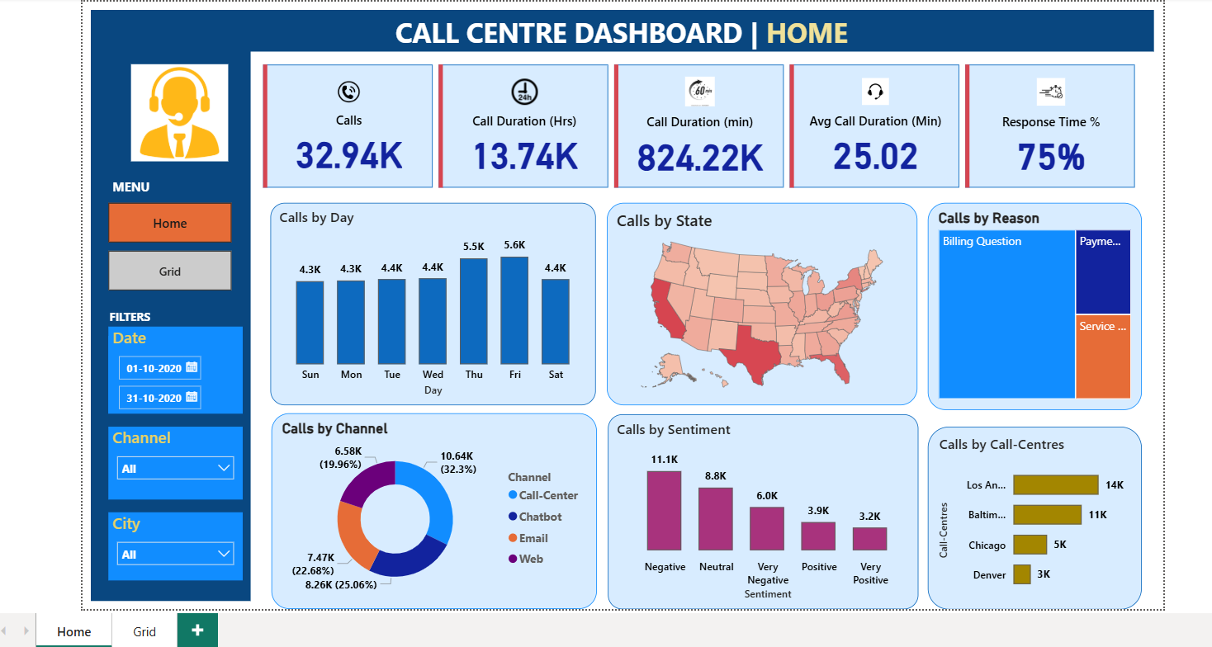

Slide 13
